Slide 1
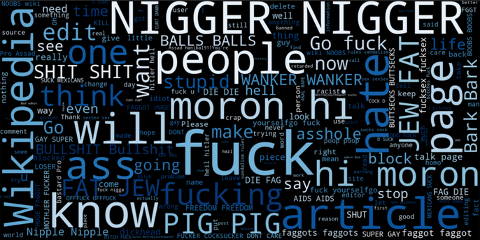
MALIGNANT COMMENT CLASSIFICATION
Malignant Comments Classifier PROJECT PRESENTATION
Shahbaz Ali

Slide 2
INTRODUCTION
People use social media as a platform to express their opinions and views.
They do this freely and without any reluctance.
With it comes the risk of cyber abuse and harassment, which can put an end to people expressing themselves and giving up on seeking opinions.
To protect the users from cyberbullying, every organization should have an automated system in place to identify such malicious comments and suitable actions against the same.

Slide 3
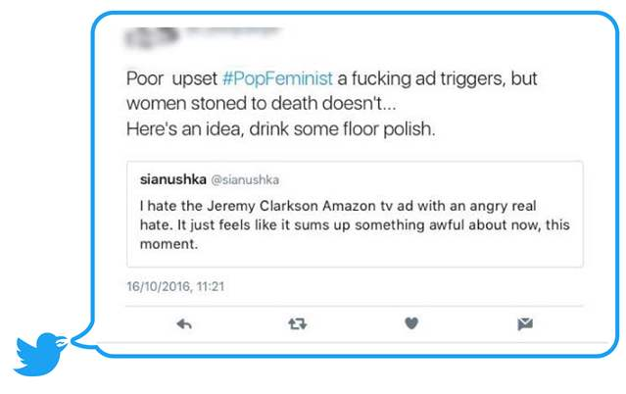
OBJECTIVE
We have undertaken this project to classify the comments made by different users on different social media platforms. To build a model that is capable of detecting and classifying these comments into various classes like malignant, highly_malignant, rude, threat , abuse , loathe.

Slide 4

DATA EXTRACTION
Data extraction is done as per the data provided by institute. The data is also present in Kaggle website. (https://www.kaggle.com/c/jigsaw-toxic-comment-classification-challenge/data)
Collection of words containing cuss words using the track parameter to gather relevant data to perform our analysis.

Slide 5

PREPROCESSING OF THE DATA
We have performed the following preprocessing on the data:
Removed punctuations
Removed special characters
Stemming and lemmatization the comments
Filtering out comments with length below 3
Applied TFIDFVectorizer which provides better performance.

Slide 6
DATA MODELLING
Problem Transformation Method
We used the Multinomial Naïve Bayes classifier for classification.
We used this classifier, since it is suitable for classification with discrete features.
We first used k-fold cross validation and compared the performance of three models without any hyperparameter tuning.
After checking how these models perform on the test data, we notice that Multinomial Naive Bayes does not perform as well as the other two models while Linear Regression in general out performs the others based on F1 score.

Slide 7
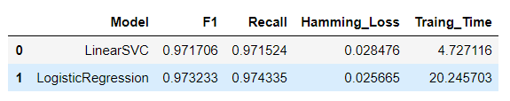
Pipeline with Manual Hyperparameter Tuning
Accounting for the imbalanced data, the F1 score of Logistic Regression model has jumped to an average of 0.973233 while Linear SVC has jumped to 0.971706.
We were able to find the "optimal" hyperparameters with help of grid search for the models and have reached an average of the best score of 0.9566 for Logistic Regression and 0.9585 for Linear SVC.
To ensemble different models, we firstly tried a few models based on tree boosting, then used a voting classifier to ensemble one of the boosting model with the basic models in previous parts. We get a F1 score and Hamming Loss using Ensembling.

Slide 8
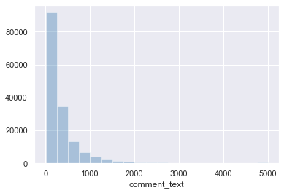
DATA VISUALIZATIONS

Slide 9
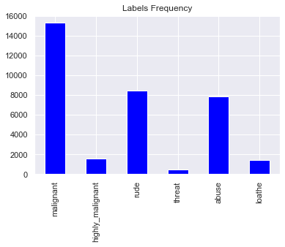
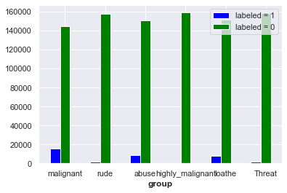
DATA VISUALIZATIONS

Slide 10

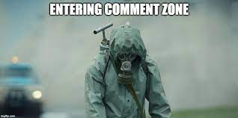
RESULTS Interpretation
Upon testing the models, we have analyzed the following:
Misclassified 1347 as non-malignant which were actually malignant.
Most of the tweets fell under the “malignant” class.
ucking is a common word in the test set.

Slide 11
CHALLENGES
Multiple labels – For Binary classification we have many models available but for multilabel classification the selection of models decreases drastically.
Collection of USABLE DATA – although we extracted over 100000 records, only 14000 records were usable among them.
Cleaning the data – Due to the character limit data contain a lot of short forms which are different to classify using bag of words model.
The data collection and imitation process took few hours to process since data was big and atlast provided with pretty good results from extracted data.

Slide 12
FUTURE SCOPE
The current project predicts the type or toxicity in the comment.
We are planning to add the following features in the future:
Analyze which age group is being malignant towards a particular group or brand.
Add feature to automatically sensitize words which are classified as malignant.
Automatically send alerts to the concerned authority if threats are classified as severe.
Handle mistakes and short forms of words to get better accuracy of the result.

Slide 13
THANK YOU

